Slide 1
Capstone Exercises
Decision Analysis and Economic Evaluation Workshop
Istanbul, Türkiye 2024

Slide 2
Capstone Exercise 1: Specify the Decision Problem
Decision Analysis and Economic Evaluation Workshop
Istanbul, Türkiye 2024

Slide 3
Capstone Exercise 1 Specify the Decision Problem
Objectives
Clarify the decision problem you are addressing
Describe
Current public health concern
Health condition(s) you are modeling
Specific population(s) affected
Current and alternative strategies
Deliverables
Create initial slides for final presentation that introduce your decision problem
Slide 1 – Title
Slide 2 – Background
Slide 3 – Objective/Decision problem and economic/clinical outcomes
Slide 4 – Strategy options

Slide 4
Capstone Exercise 1 Specify the Decision Problem
Examples
Assess the cost-effectiveness of community-based A, community-based B, and hospital-based hypertension screening options among Thai population aged 18+
Assess the tradeoffs of implementing mass rotavirus vaccination of newborns in India
Compare cost-effectiveness of strategies for prevention of malaria:
Distribution of insecticide-treated nets
Seasonal malaria prophylaxis

Slide 5
Capstone Exercise 2: Build a Decision Tree
Decision Analysis and Economic Evaluation Workshop
Istanbul, Türkiye 2024

Slide 6
Capstone Exercise 2 Build a Decision Tree
Objectives
Construct a decision tree in Amua comparing the status quo to your specific strategy(ies)
Parameterize decision tree and estimate outcomes
Deliverables
Create slide for final presentation that graphically displays your decision options using a decision tree
Slide 5 – Decision tree graphic with expected values

Slide 7
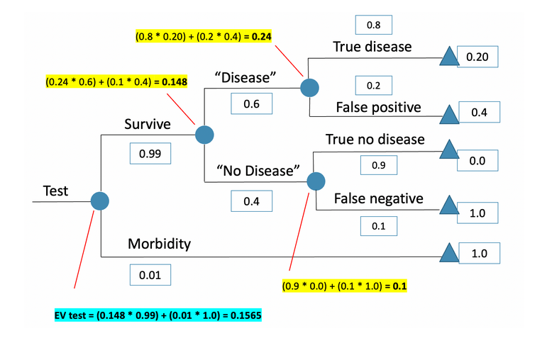
Capstone Exercise 2 Build a Decision Tree
Example

Slide 8
Capstone Exercise 3: Group Work
Decision Analysis and Economic Evaluation Workshop
Istanbul, Türkiye 2024

Slide 9
Capstone Exercise 3 Group Work
Objective
Work as a team to refine your decision problem and strategies based on your Amua decision tree
Deliverable
Refined descriptions of decision problem and strategies
Slide 3 – Objective/Decision problem
Slide 4 – Strategy options

Slide 10
Capstone Exercise 4: Paired Group Work
Decision Analysis and Economic Evaluation Workshop
Istanbul, Türkiye 2024

Slide 11
Capstone Exercise 4 Paired Group Work
Objective
Present Background, Objective/Decision Problem, and Strategy Options to other team
5-minute presentation
Provide feedback on clarity and completeness of descriptions
Switch presenting team/feedback team at halfway point
Deliverable
Refined descriptions of background, decision problem, and strategies
Slide 2 – Background
Slide 3 – Objective/Decision problem
Slide 4 – Strategy options

Slide 12
Capstone Exercise 5: Design the Markov Model
Decision Analysis and Economic Evaluation Workshop
Istanbul, Türkiye 2024

Slide 13
Capstone Exercise 5 Design a Markov Model
Objective
Use your decision problem and strategies from slides 3, 4, and 5
Determine the health states of the decision problem
Determine the transitions
Determine parameters
Population
Cycle length
Time horizon
Probabilities (fill in later)
Deliverable
Create slide for final presentation that displays your decision problem as a Markov schematic
Slide 6 – bubble diagram graphic, parameter table headers, transition matrix framework

Slide 14
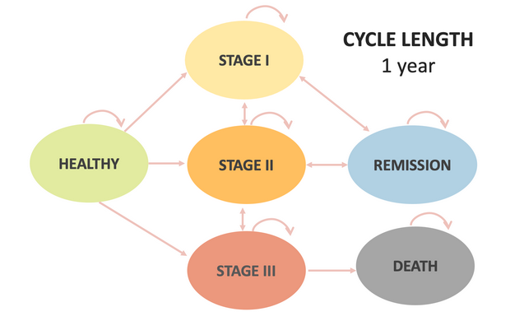
Capstone Exercise 5 Design a Markov Model
Parameter Table
param | Base_case | description | notes | distribution | source
n_age_init |  | Age at baseline
n_age_max |  | Maximum age of followup
c_S |  | Annual cost of sick(S)
Examples
Transition Matrix
 | Healthy | Stage I | Stage II | Stage III | Remission | Death
Healthy
Stage I | 0
Stage II | 0 | 0
Stage III | 0 | 0 | 0
Remission | 0 | 0 | 0 | 0
Death | 0 | 0 | 0 | 0 | 0 | 1

Slide 15
Capstone Exercise 6: Build & Run the Markov Model
Decision Analysis and Economic Evaluation Workshop
Istanbul, Türkiye 2024

Slide 16
Capstone Exercise 6 Build & Run the Markov Model
Objective
Determine parameter estimates and complete the parameter table
Determine transition probabilities and fill in the transition matrix
Run Markov model in Amua
Deliverable
Create slides for final presentation that fills in and documents your Markov model inputs and calculation
Slide 7 – filled in parameter table, transition matrix
Slide 8 – Markov bubble schematic and “reward” calculations

Slide 17
Capstone Exercise 6 Build a Markov Model
Examples
Parameter Table
param | Base_case | description | notes | distribution | source
n_age_init | 25.00 | Age at baseline |  |  | Modeling parameter
n_age_max | 100.00 | Maximum age of followup |  |  | Modeling parameter
c_S | 1000.00 | Annual cost of sick(S) |  | gamma (shape=44.4, scale=22.5) | Graves et al. (2022)
r_ mortality | 0.15 | Rate of mortality |  |  | Assumption
Transition Matrix
 | Healthy | Sick | Dead
Healthy | 0.856 | 0.138 | 0.007
Sick | 0 | 0.982 | 0.018
Dead | 0 | 0 | 1

Slide 18
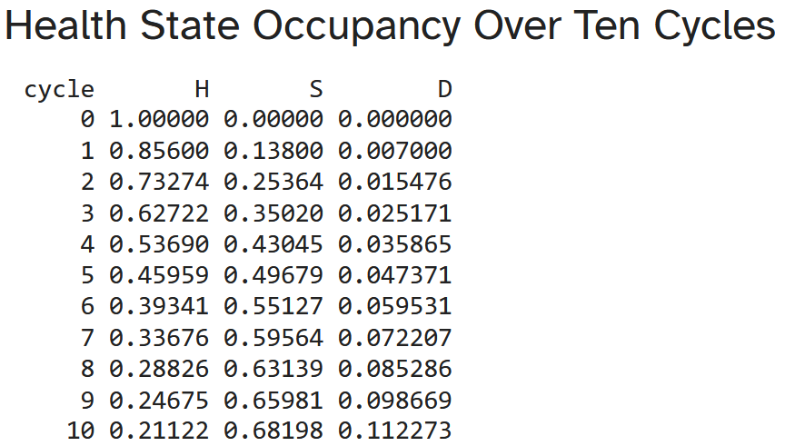
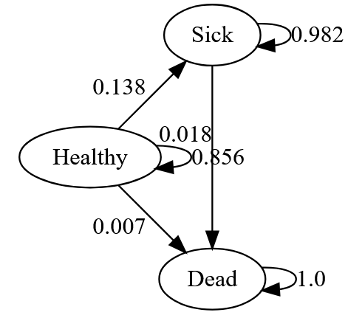
Capstone Exercise 6 Build a Markov Model
Examples

